Slide 1
— Point-Cloud-Res-Net (PCRN)
Alexandre Duperre
November 25th 2019
Notes:
To create Em dash above headline:
Same size and weight as the headline and set using a soft return.
PC: Em dash (—): Alt+Ctrl+ - (minus)
Mac: Em dash (—): Shift+Alt/Option+hyphen

Slide 2
Table of contents
Problematic
Method
Datasets
Model 1 - PCRN
Model 2 – PrimalNet
Conclusion

Slide 3
Objective : Classification from depth information
i.e.: 2.5D images, point clouds

Slide 4
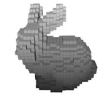
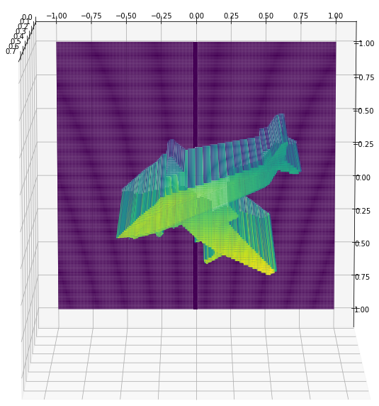
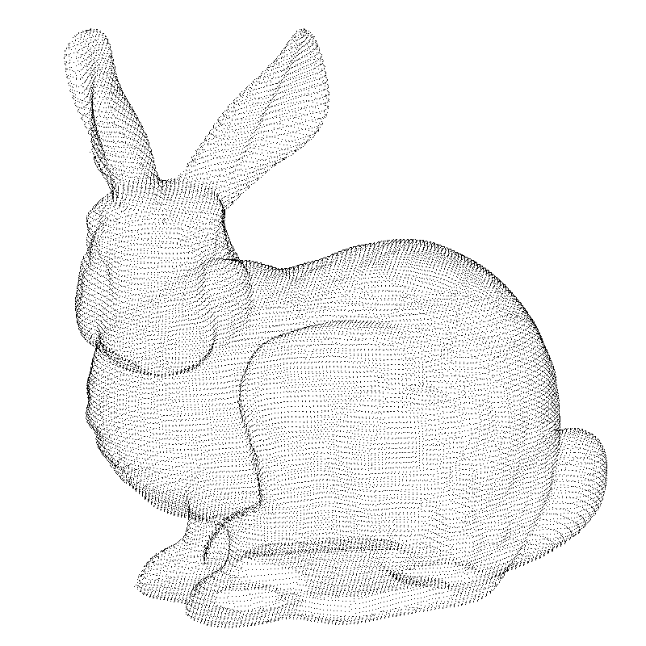
Problematic
Classification of 3D and 2.5D objects
Regular domains
Ours
Irregular domains
Notes:
As 2.5D and 3D scanners like kinects are becoming wildly used, the data generated by those also becomes more and more accessible. This allows us to try to develop classification algorithms for higher dimension data.
Two types approaches are currently being investigated :
Methods using regular domains: 3D voxels (occupancy maps), 2D rendered images from 3D PC, Graphs, trees
Methods using irregular domains: uses PC directly
Since 2.5D scanners are more likely to be used in real time application, we are trying to see if we can define a model that can classify different shapes using 2.5D generated images from 3D point clouds.
The next step to this project would be to use this type of algorithm to identify these objects in a real time scene containing different objects like Mask-CNNs are doing.
But at our stage, we are focusing in learning how to classify objects individually.

Slide 5
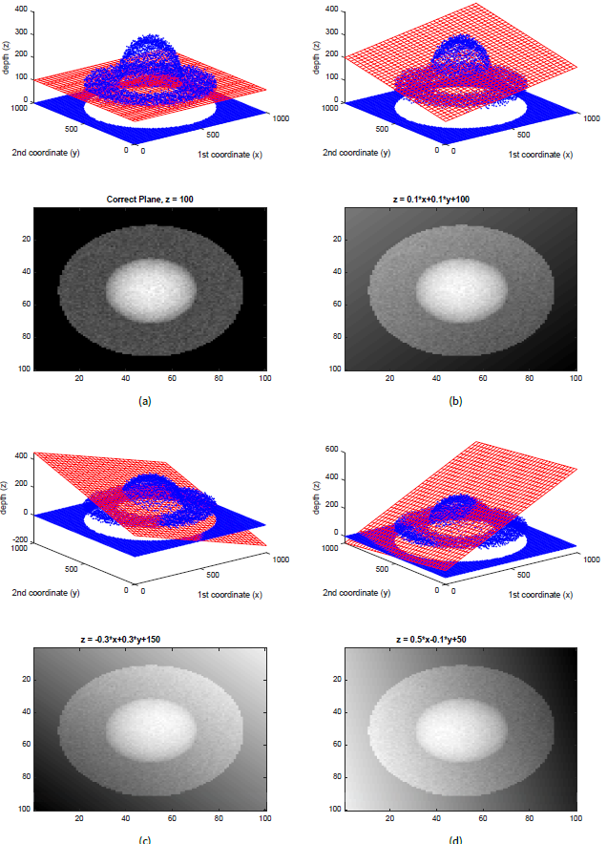
Method : 3D Residuals
Hypothesis: 3 residual images for each geometric primitive is enough to create a rich representation of the 2.5D input
Our algorithm will learn the best parameters corresponding to each parametric shape
i.e.:
3 planes = 3 sets of parameters
3 spheres = 3 sets of parameters
3 cylinders 3 sets of parameters
…
Notes:
What is a residual: image where each pixel is the shortest distance to a primitive shape
In short: It’s a measure of how similar the input is to a primitive

Slide 6
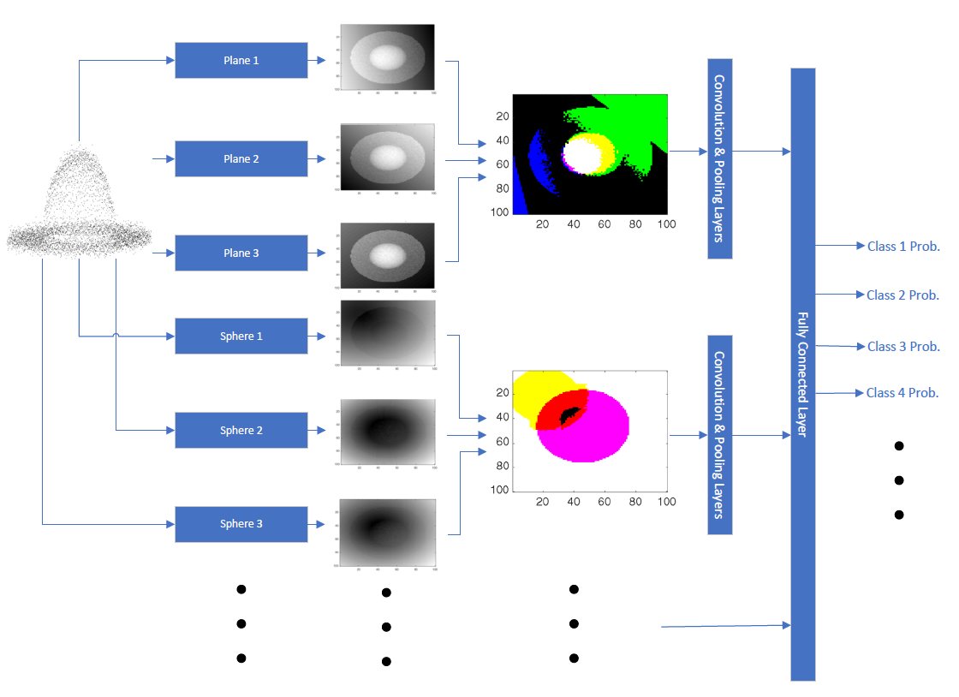
Method : 3D Residuals
Hypothesis: Merging the Residual network with a powerful classifier will yield good accuracy performances
The first algorithm calculates the residual images with respect to the learned primitives.
The 3 residual images per type of primitive are fed to the ResNext101_32-4d.

Slide 7
Datasets : 3D models
ShapeNet V2 & ModelNet40

Slide 8


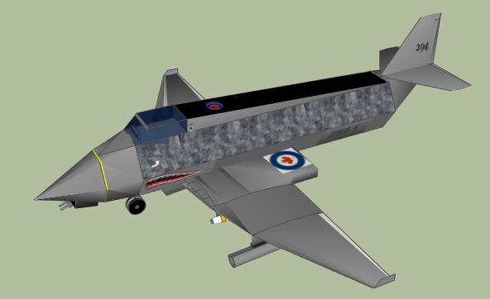




Originally : Pre-processing
From 3D models (.obj) to multi-view (MV) 2.5D image dataset
Stanford ShapeNet Renderer (Panamari, 2018)
Pixel value inversion needed
Notes:
Very time consuming but happens only once.
Limited in number of views

Slide 9
Now: Automated depth image generation
From 3D models (.off) to randomly rotated 2.5D image
Integrated pyrender module within dataloader
Better centred views
Unlimited rotation angles
No pre-processing
Notes:
Pros: Takes as input OFF file directly, better model (more angles)
Cons: Slower at training time, UNIX operating systems only

Slide 10
Model 1 : PCRN
PlaneResLayer
Conv Block
ResNext101-32x4d
PlaneResLayer
Outputs
[B, 3, H, W]
[B, 3, H*W]
PlaneResLayer
[B, 3*ConvBlock_out, H, W]
ShpereResLayer
Conv Block
ShpereResLayer
ShpereResLayer
CylResLayer
Conv Block
CylResLayer
CylResLayer
ResBlocks

Slide 11
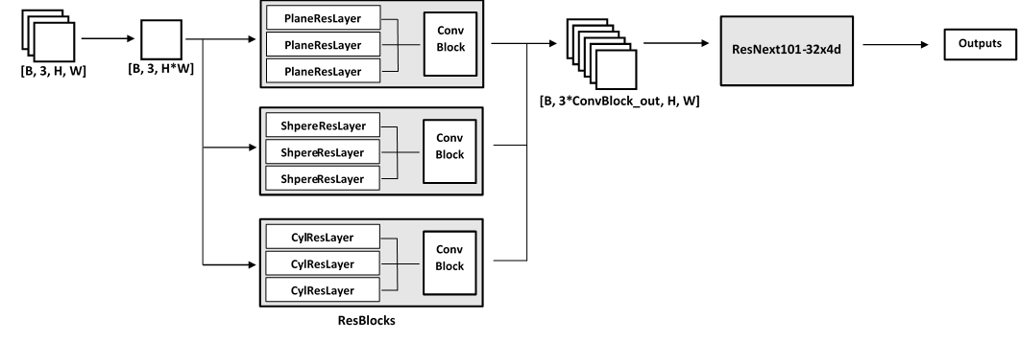
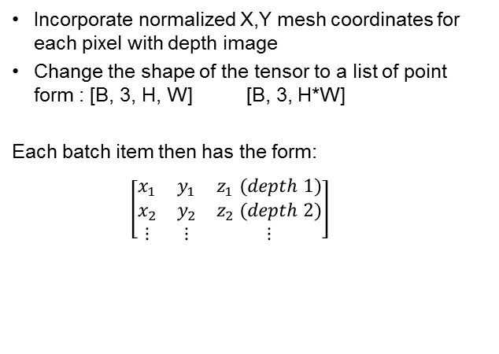
Prepare the data
Key elements
Incorporate normalized X,Y mesh coordinates for each pixel with depth image
Change the shape of the tensor to a list of point form : [B, 3, H, W] [B, 3, H*W]
Each batch item then has the form:
$\left[\begin{matrix}x_{1} & y_{1} & z_{1} (depth 1) \\ x_{2} & y_{2} & z_{2} (depth 2) \\ ⋮ & ⋮ & ⋮\end{matrix}\right]$
Notes:
Reshape the input in a way that is easier for the residual computation.
Actually happens outside of the model ➔ possible improvement

Slide 12
Compute Residuals
Key elements
3 ResBlock
3 ResLayers for Each ResBlock
The 3 residual images are concatenated along the channel axis
The three channel residual image is fed to a small convolutional neural network
Output is a stacked along the channel axis

Slide 13
Feed ResNext101_32-4d
Modified elements in ResNext101_32-4d
First convolution layer of ResNext101-32-4d
Last linear fully connected layer
Number of classes to predict

Slide 14

Other features
Weight clipper : keep parametric primitives parameters within 0,1 range
Tuneable learning rate for the ResidualNet layer (fixed)
Confusion matrix generator
Primitive evolution throughout training
NEW:
Random initialization of the primitives
Pretraining
Image downsizing for faster training
Focal loss
Weighted loss
Batch Norm and tanh activation

Slide 15
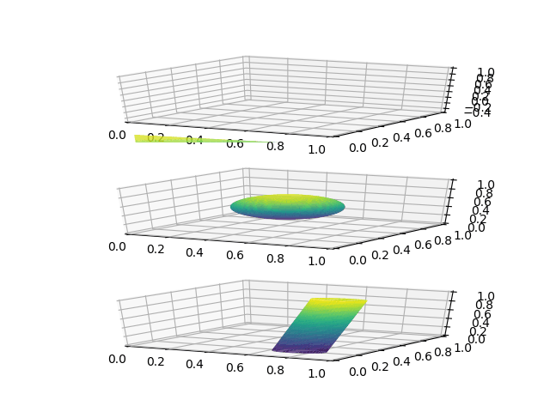
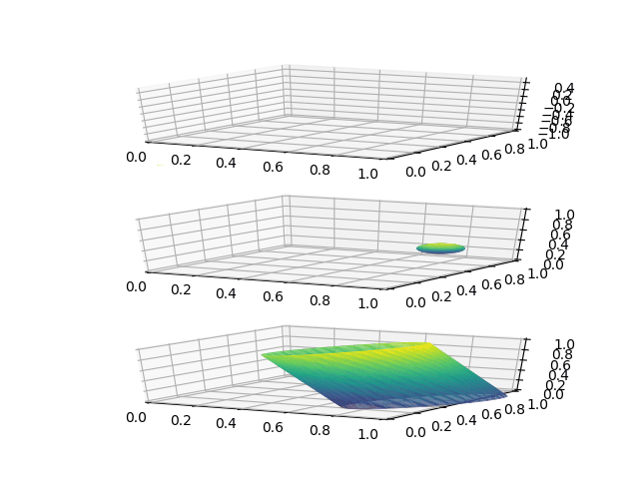
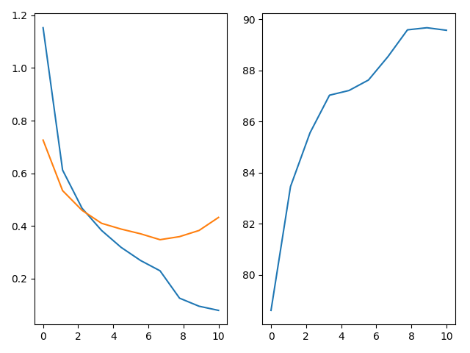
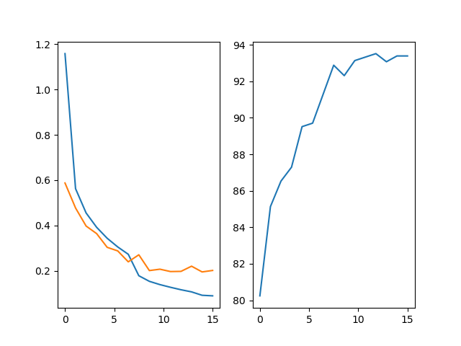
Results : ShapeNet - PCRN
Validation Accuracy
Validation Accuracy
Loss
Loss
Training
Validation
Training
Validation
Primitive evolution without layer specific learning rate
Primitive evolution with layer specific learning rate
Learning curves
Test accuracy : 89,69%

Slide 16
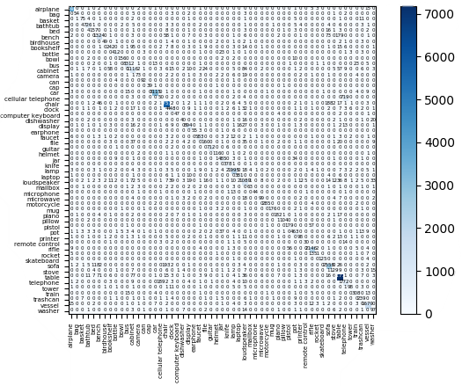
Results : ShapeNet- PCRN
Confusion Matrix
Phone is mistaken for cellular phone
Chair is mistaken for sofa or bench
Table is mistaken for bench
Loudspeaker is mistaken for cabinet
etc,

Slide 17
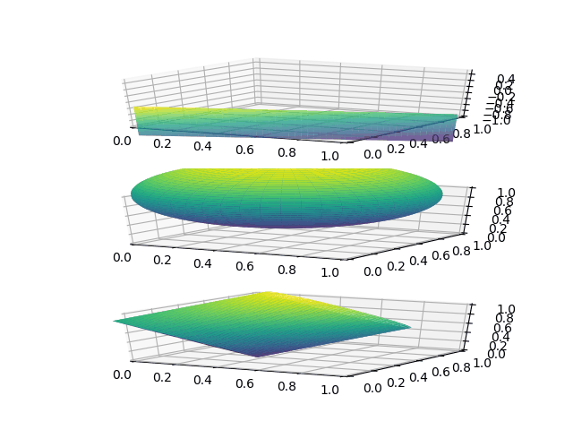
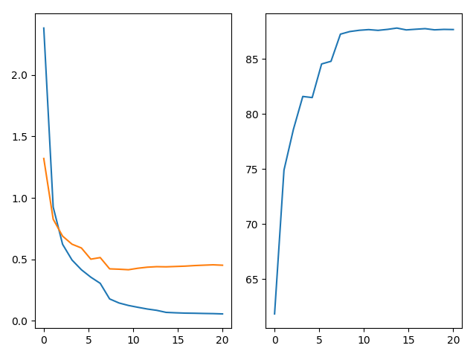
Results : Pre-processed ModelNet40 - PCRN
Validation Accuracy
Loss
Training
Validation
Learning curves
Test accuracy : 87,23%
Best accuracy : 87,51%
Primitive evolution with layer specific learning rate

Slide 18
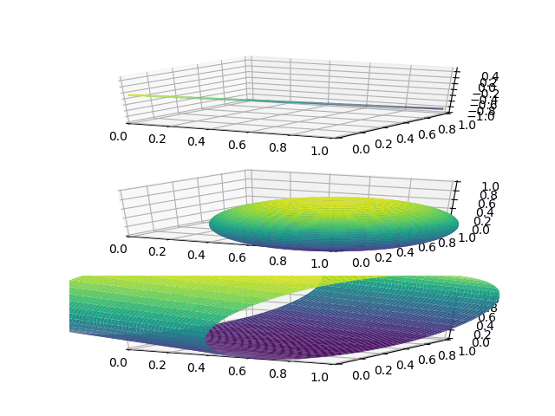
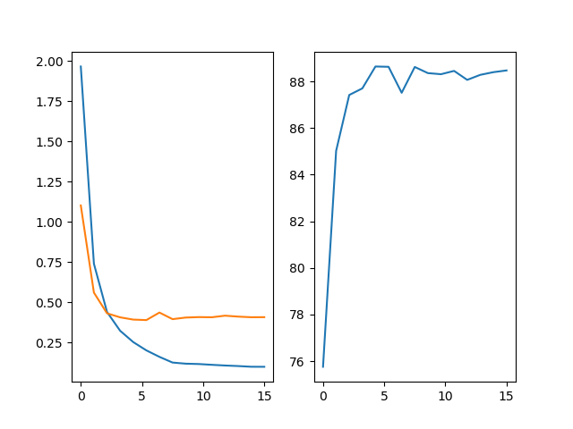
Results : pretrained ModelNet40 - PCRN
Validation Accuracy
Loss
Training
Validation
Learning curves
Test accuracy : 88,47%
Best accuracy : 88,64%
Shape evolution with layer specific learning rate

Slide 19
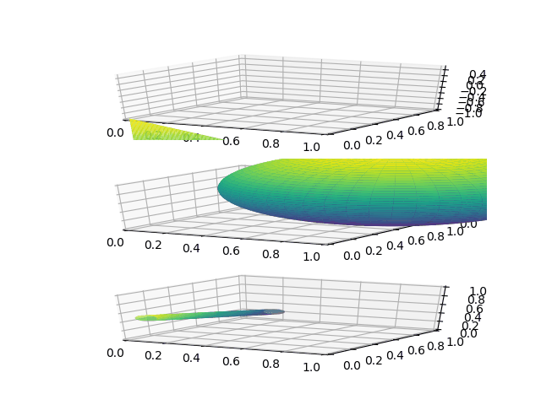
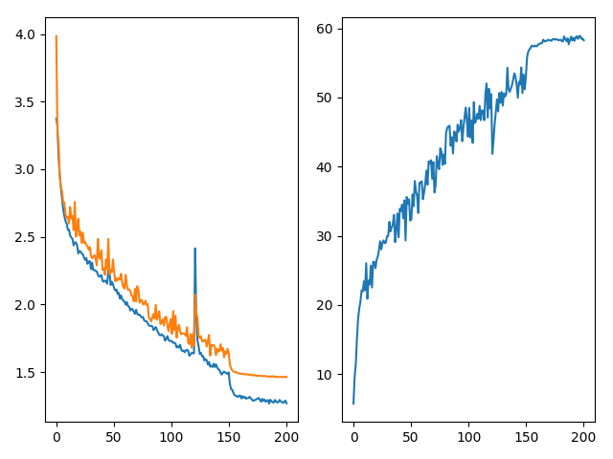
Results : Raw ModelNet40 - PCRN
Validation Accuracy
Loss
Training
Validation
Learning curves
Test accuracy : 58,26%
Best accuracy : 58,63%
Primitive evolution with layer specific learning rate
Notes:
Primitive not available as data has been washed away from the server

Slide 20
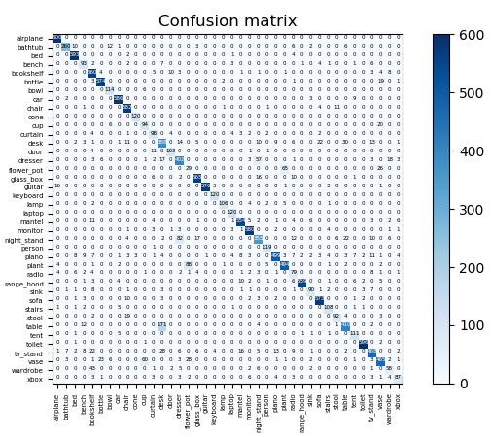
Results : Raw ModelNet40 - PCRN
Confusion Matrix
Pre-processed ModelNet40
Notes:
TO DO

Slide 21
In short - PCRN
ShapeNet : Decent performance
ModelNet40 :
Pre-processed : Lower results due to less data
Pre-trained : Slight increase in performance
Raw dataset (.OFF) : Has potential if better training, less robust to classify similar objects
Convergence of the primitives : No clear behaviour in the evolution of the primitives; classification network is invariant
Notes:
ShapeNet: no significant overfitting, no comparable
ModelNet40 pre-processed: no significant overfitting,
ModelNet40 pre-trained : increase mainly due to the fact that ModelNet = subset of ShapeNet + other
RAW OFF : ?????????????
Convergence of primitives: some grow (to become plane-like) some shrink… Classif net simply adapts to the primitives, proof: no change in perfs after implementing random init.

Slide 22

Model 2 : PrimalNet
d = 1
1x1 Conv
ResNext101-32x4d
Outputs
x, y, z
x, y, z
n = 3
d = 2
1x1 Conv
x, y, z, xy, xz, yz, x², y², z²
d = N
1x1 Conv
$\left(\frac{d+n−1}{n−1}\right)$ channels

Slide 23
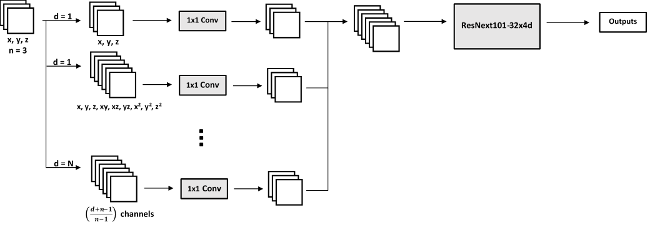

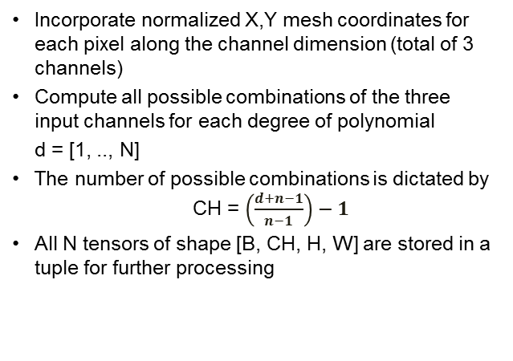
Prepare the data
Incorporate normalized X,Y mesh coordinates for each pixel along the channel dimension (total of 3 channels)
Compute all possible combinations of the three input channels for each degree of polynomial
d = [1, .., N]
The number of possible combinations is dictated by CH = $\left(\frac{d+n−1}{n−1}\right)−1$
All N tensors of shape [B, CH, H, W] are stored in a tuple for further processing
1
Notes:
complete homogeneous symmetric polynomials.
Depending on how many degree we want, the network will generate all the possible monomials for each polynomial of degree d.

Slide 24
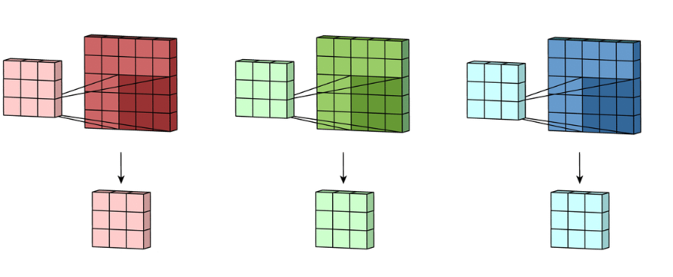
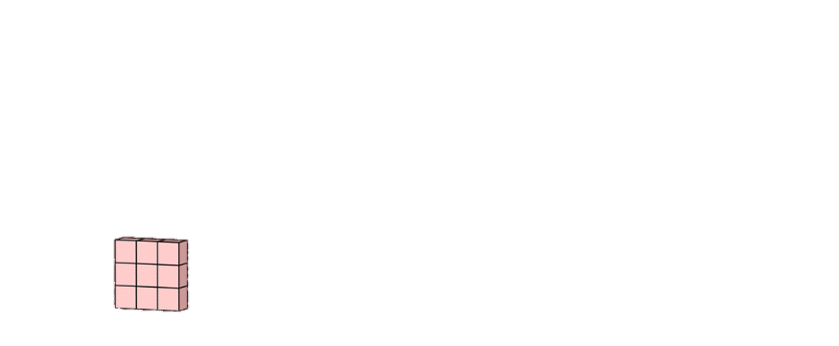

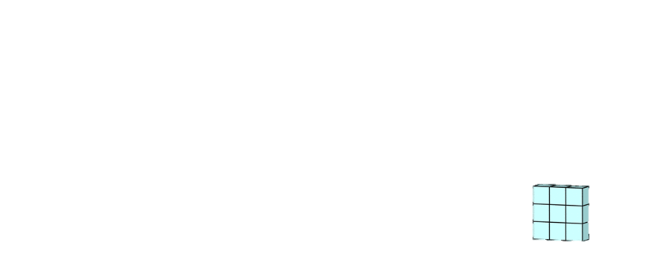
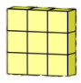
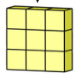
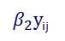
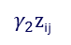

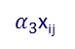
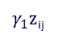
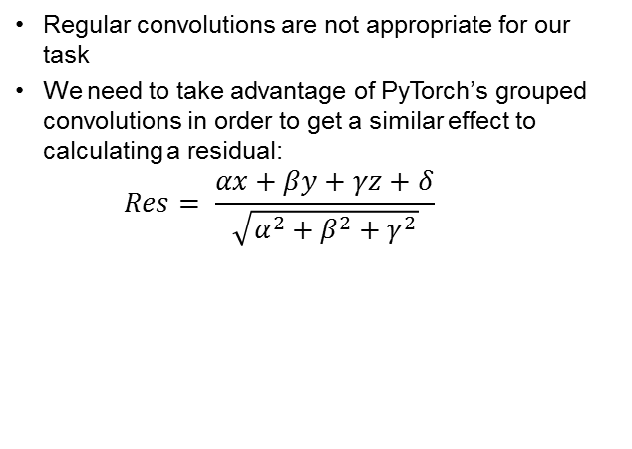
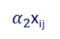
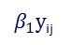
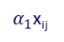
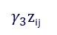
1x1 Convolution layer
x
y
z
1
$α_{1}$x_{ij}
$α_{2}$x_{ij}
$α_{3}$x_{ij}
$β_{1}y$_{ij}
$β_{2}y$_{ij}
$β_{3}y$_{ij}
$γ_{1}z$_{ij}
$γ_{2}z$_{ij}
$γ_{3}z$_{ij}
+
+
+
1
Regular convolutions are not appropriate for our task
We need to take advantage of PyTorch’s grouped convolutions in order to get a similar effect to calculating a residual:
$$Res= \frac{αx+βy+γz+δ}{\sqrt{α^{2}+β^{2}+γ^{2}}}$$

Slide 25
Feed ResNext101_32-4d
TO MODIFY
First convolution layer of ResNext101-32-4d
Last linear fully connected layer
Number of classes to predict
1

Slide 26
Other features
Tuneable learning rate for the ResidualNet layer
Confusion matrix generator
NEW:
Gaussian/tanh activation function
Pretraining
Image downsizing for faster training
Focal loss
Weighted loss
Weight normalization

Slide 27
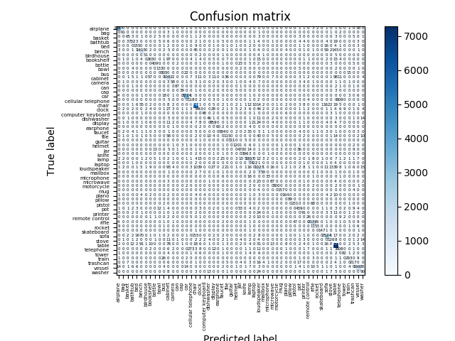
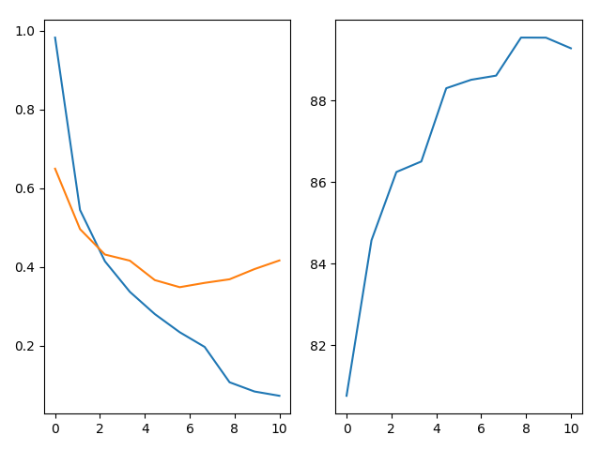
Results : ShapeNet - PrimalNet
Validation Accuracy
Loss
Training
Validation
Learning curves
Test accuracy : 89,47%

Slide 28
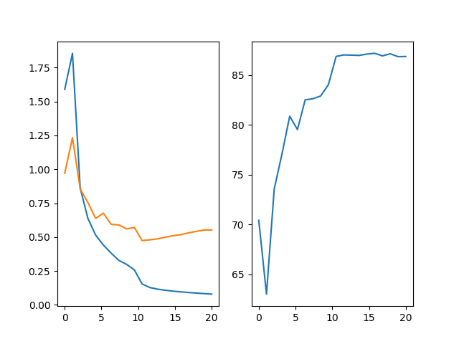
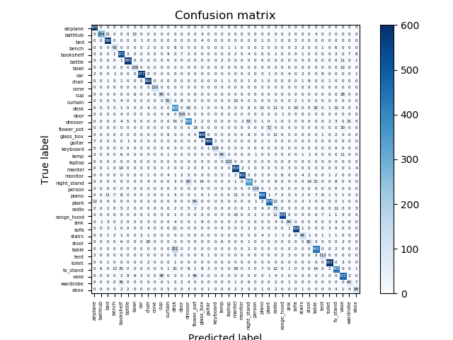
Results : Pre-processed ModelNet40 - PrimalNet
Validation Accuracy
Loss
Training
Validation
Learning curves
Test accuracy : 86,88%
Best accuracy : 87,20%

Slide 29
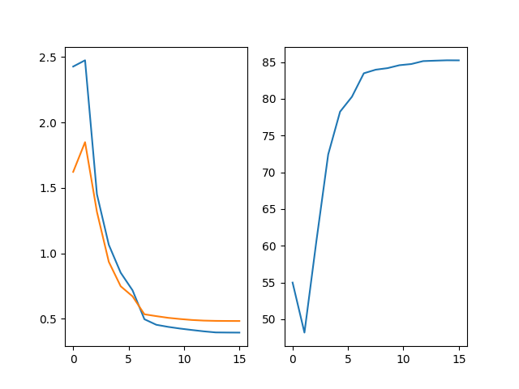
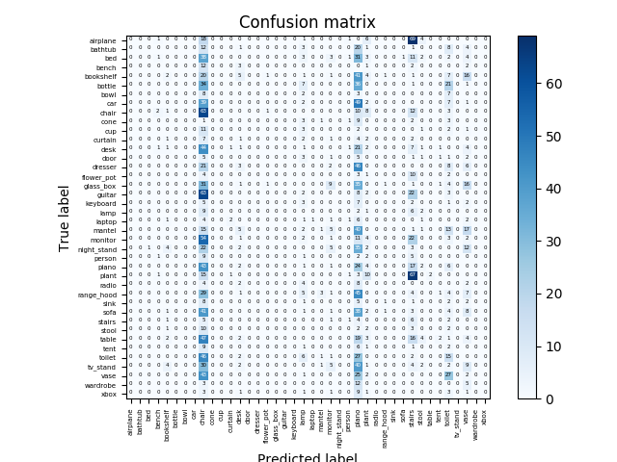
Results : Test on raw ModelNet40 - PrimalNet
Validation Accuracy
Loss
Training
Validation
Learning curves
Validation accuracy : 85,23%
Test accuracy : 5,11%
Notes:
Chair , piano or stairs

Slide 30
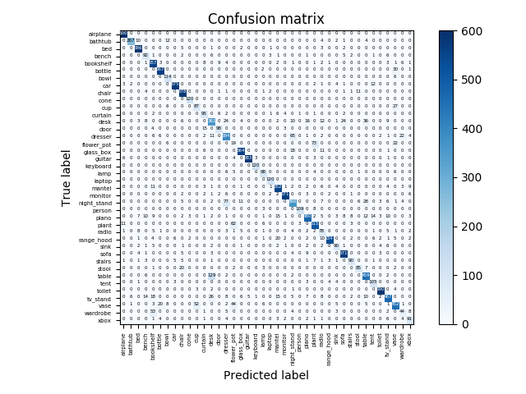
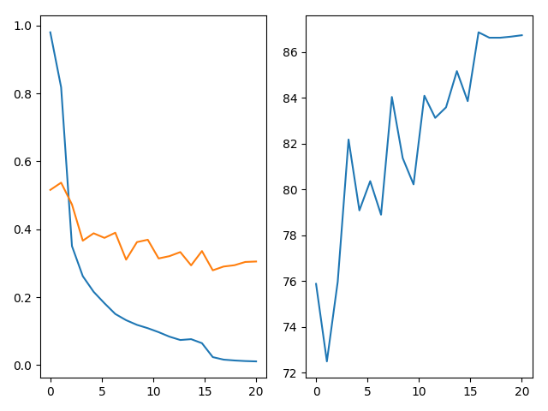
Results : pretrained ModelNet40 - PrimalNet
Loss
Validation Accuracy
Training
Validation
Learning curves
Test accuracy : 87,25%

Slide 31
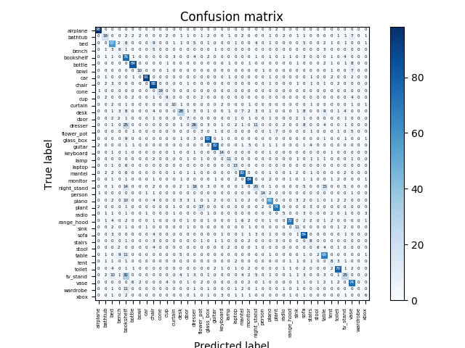
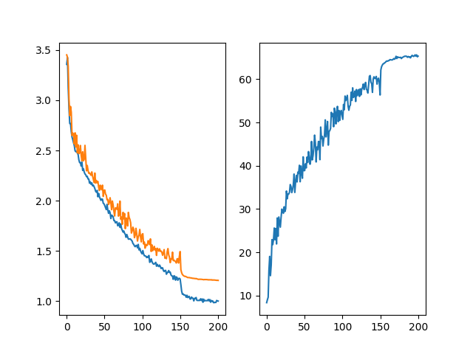
Results : Raw ModelNet40 - PrimalNet
Loss
Validation Accuracy
Training
Validation
Learning curves
Test accuracy : 65,36%
Best accuracy : 65,64%
Notes:
A lot less data: no augmentation so smaller epochs resulting on noiser graphs
Bookshelf: cube-like objects

Slide 32
In short - PCRN
ShapeNet : Decent performance
ModelNet40 :
Pre-processed : Lower results due to less data
Pre-processed then test on raw: Very poor results showing adaptation to the regular points of view
Pre-trained : Slight increase in performance
Raw dataset (.OFF) : Has potential if better training, less robust to classify similar objects
Notes:
ShapeNet: no significant overfitting
ModelNet40 pre-processed: no significant overfitting,
ModelNet40 pre-trained : increase mainly due to the fact that ModelNet = subset of ShapeNet + other

Slide 33
Conclusion – PCRN vs PrimalNet
 |  | PCRN | PrimalNet
Pre-processed ShapeNet |  | 89,69 | 89,47
 | ModelNet40 | 87,23 | 86,88
(pre-trained) | ModelNet40 | 88,47 | 87,25
Raw ModelNet40 |  | 58,63 | 65,36
PrimalNet almost as good as PCRN
Similarity between the two : similar to a regular CNN?
Further testing should be done
Inferior to the pioneers in Point Cloud classification & current SOA
Notes:
PCRN VS PrimalNet: Noise? Device and batch size related?
Deduction: We can assume that both networks do the same thing. Can we assume that a basic CNN does the same thing and use the residuals as explanations to CNN?
Results : Although multiple tests have been conducted, more tests should be done to validate the results ( so many hyperparams, device variations etc) => hard to do with current hardware
Comparison: PointNet 89,2%, PointNet++ 91,9%.... Best: RotationNet 97,37% learned how to take multiple points of view of the Point clouds
What can we explain from this? Considering the primitives doesn’t seem to have an effect.

Slide 34
Future improvements
Learn the best rotation for an input
What else ??

Slide 35
Suggestions / Questions?

